Slide 1
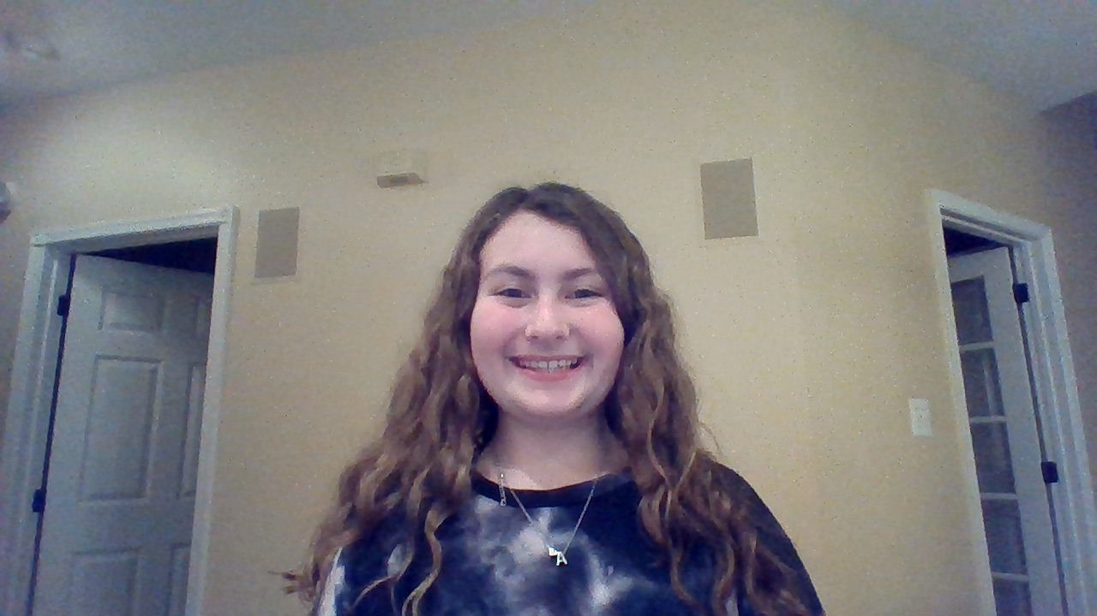

Slide 2
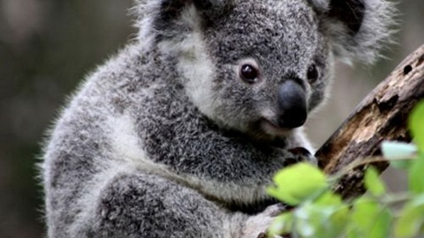
Koalas
By: Alexa Bowers

Slide 3
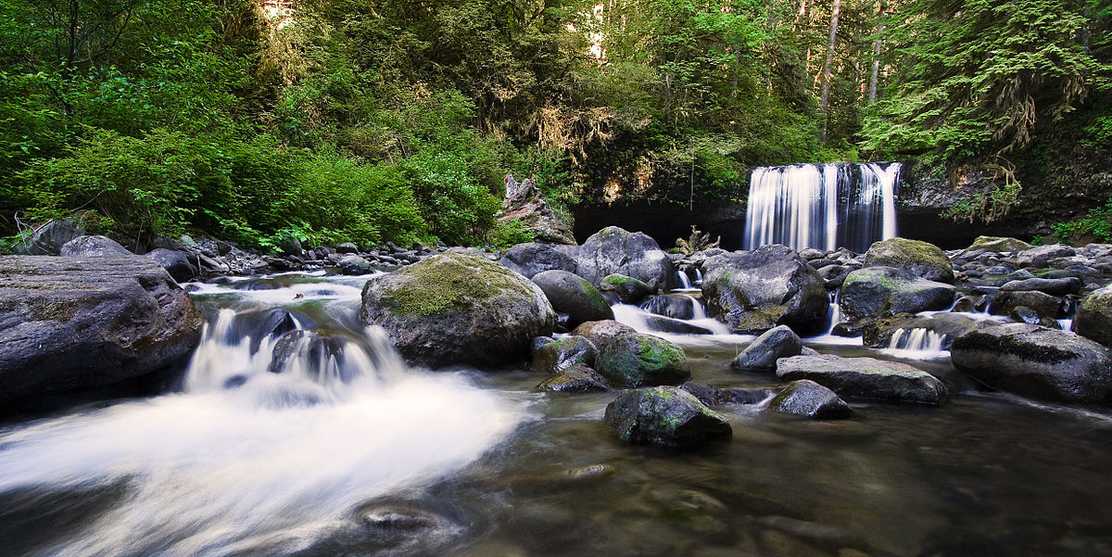
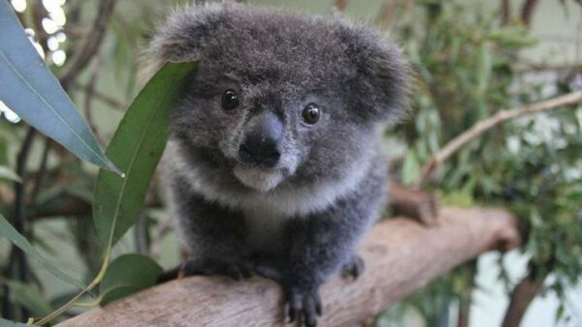
There Habitat
They live in nearby streams and creeks provide refuge during times of drought and extreme heat.
Also, they like to live in open forests to woodlands.
.

Slide 4
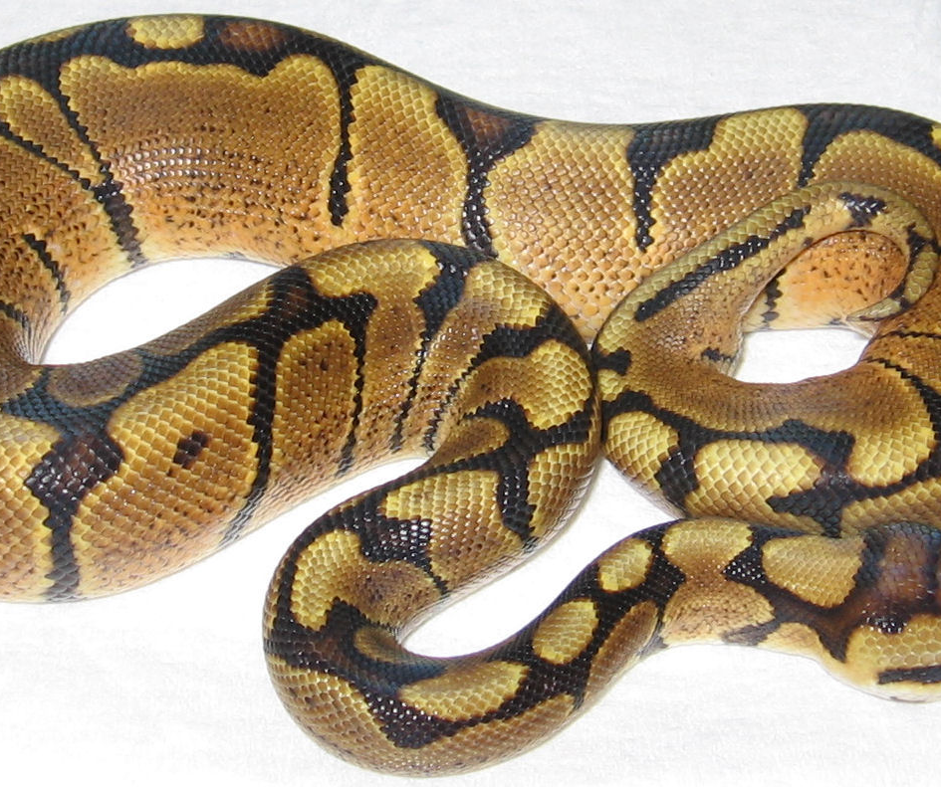
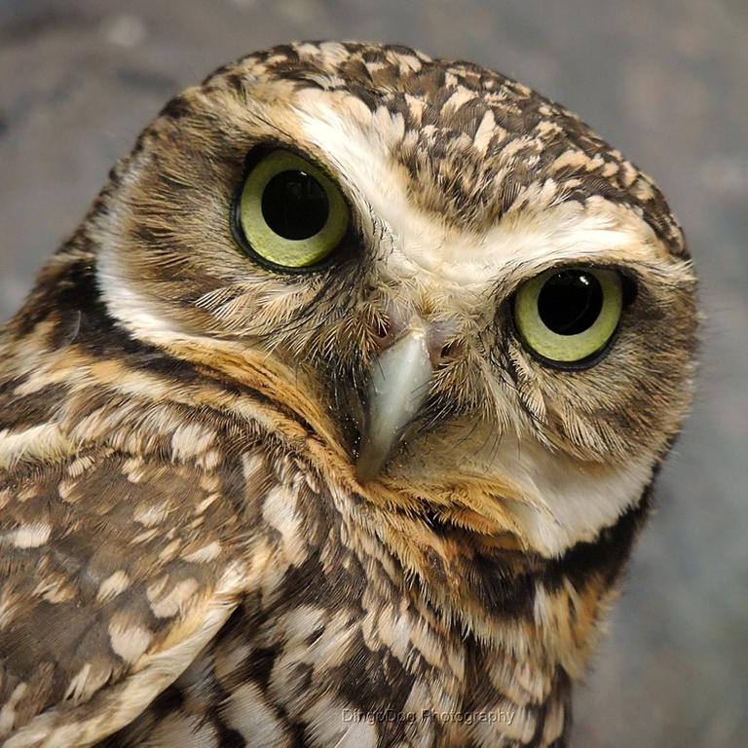
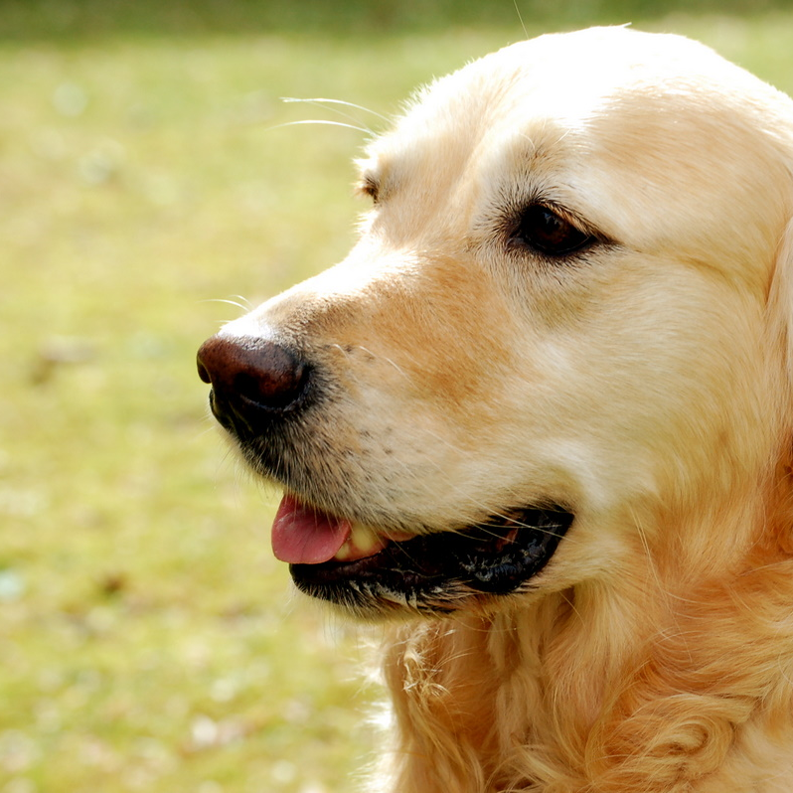
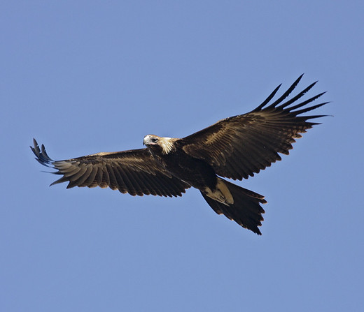
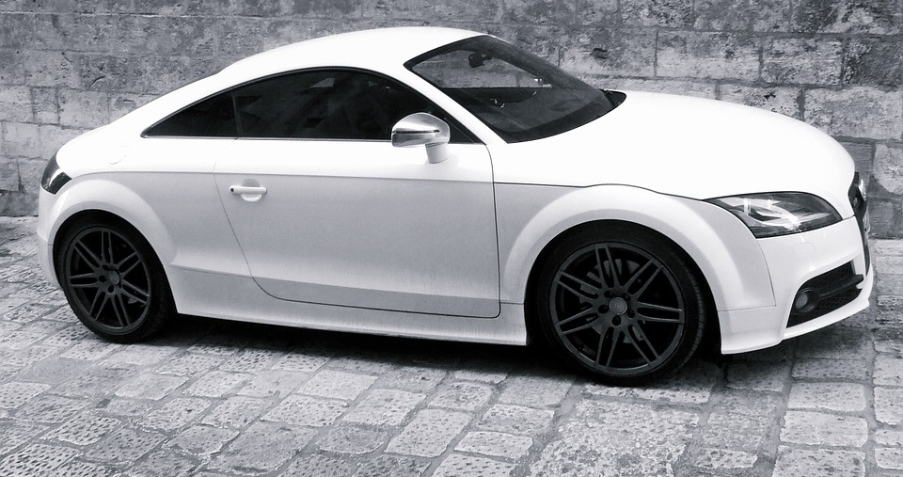
Problems Koalas have/ threats
Koalas are facing many problem. Destruction and fragmentation is the biggest threat to our koala's survival.
Also, there is more disturbance by humans and injury or death from traffic.
Over 4,000 Koalas are killed each year by cars, dogs, owls, wedge-tailed eagles, and pythons.
.

Slide 5
Fragmentation means:
Braking
Cracking
Shattering
Splitting
Bursting
These are all words that mean Fragmentation

Slide 6
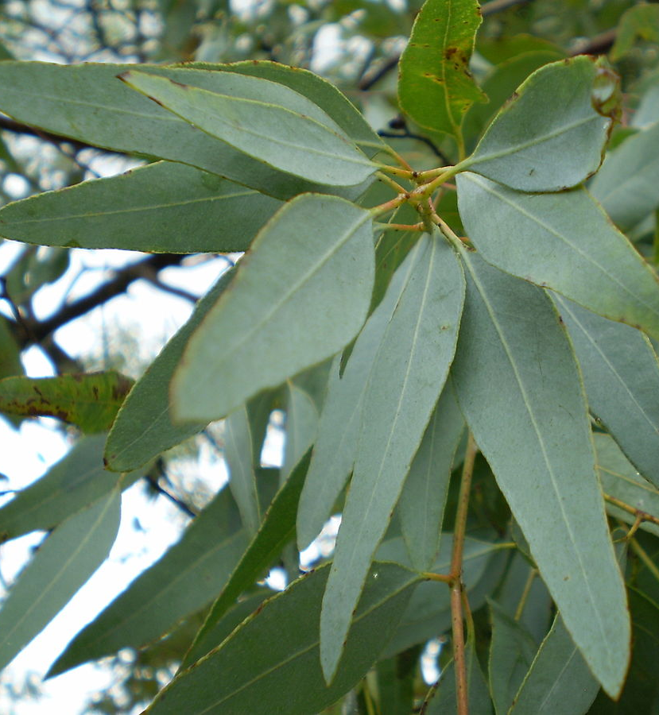
The food they eat
They are very picky with their food
They eat eucalypt Leaves
These leaves have low protein. These bears have unique behavioral characteristics in that they are capable to remain stationary for about 18-22 hours a day. Most of their time is spent on sleeping.

Slide 7
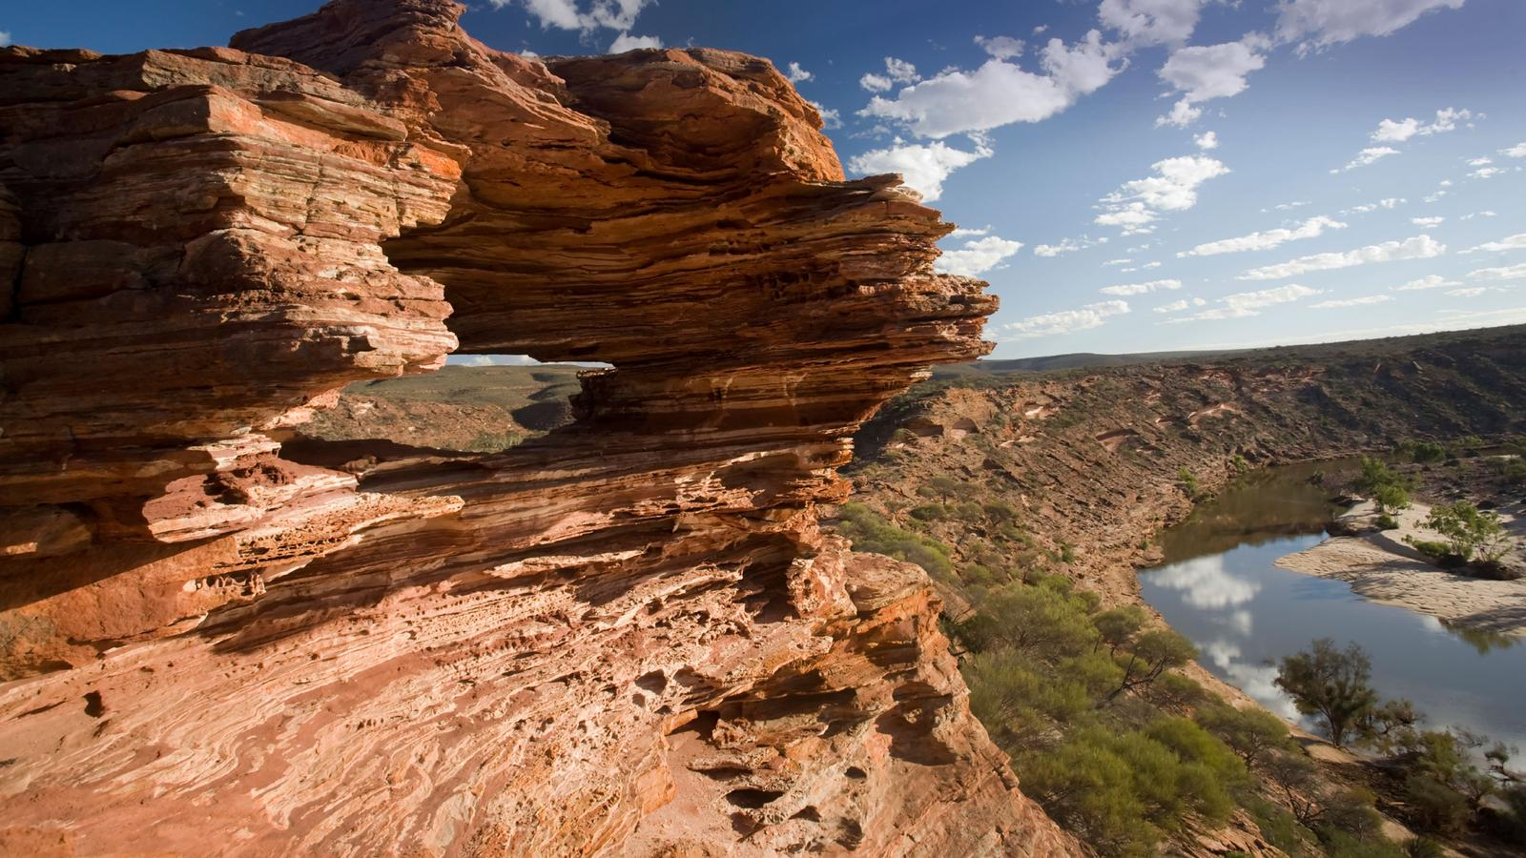
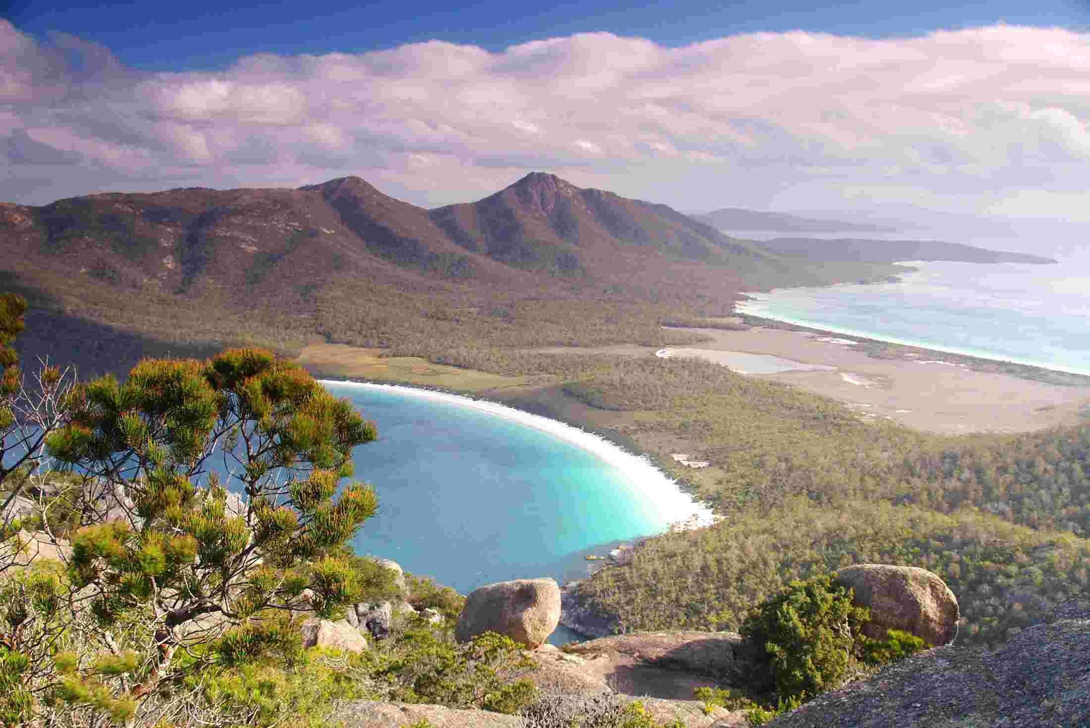
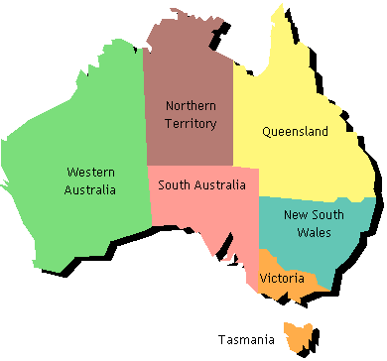
Are they Extinct?
Koalas have gone extinct in Tasmania or Western Australia.
Overall, Koalas are not going to go fully extinct in Australia because of the fires a lot are dying but not fully extinct.

Slide 8
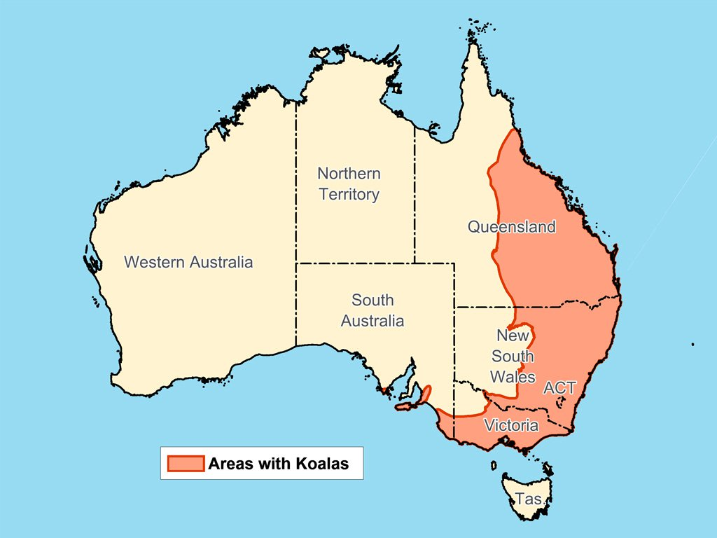
Were Kolas do live
It is estimated that 200 species live in Australia and 70 live in America.
Koalas do not live in rainforests or desert areas. They live in the tall eucalypt forests and low eucalypt woodlands of mainland eastern Australia, and on some islands off the southern and eastern coasts.

Slide 9
Are Koalas dangerous?
They only get vicious when they feel their life is in danger.
Koalas can be dangerous if you approach one so just be careful if you can near one.
If we just leave them alone, they will leave us alone.

Slide 10
Quiz time
1. What do koalas like to eat?
A. grass b. eucalypt leaves c. birds
2. True or False, Koalas live in rainforests and desserts?
3. Where have koalas gone extinct? There are two answers.
a. Western Australia b. America c. Tasmania d. South Australia
4. What are three threats to Koalas?
a. cars b. horses c. dogs d. cats e. owls
5. True or False, Koalas are picky with food?
6. Yes or No, Do Koalas like to sleep?

Slide 11
Any questions?
This Photo by Unknown author is licensed under CC BY.

Slide 12
Hope you enjoyed!

